Slide 1
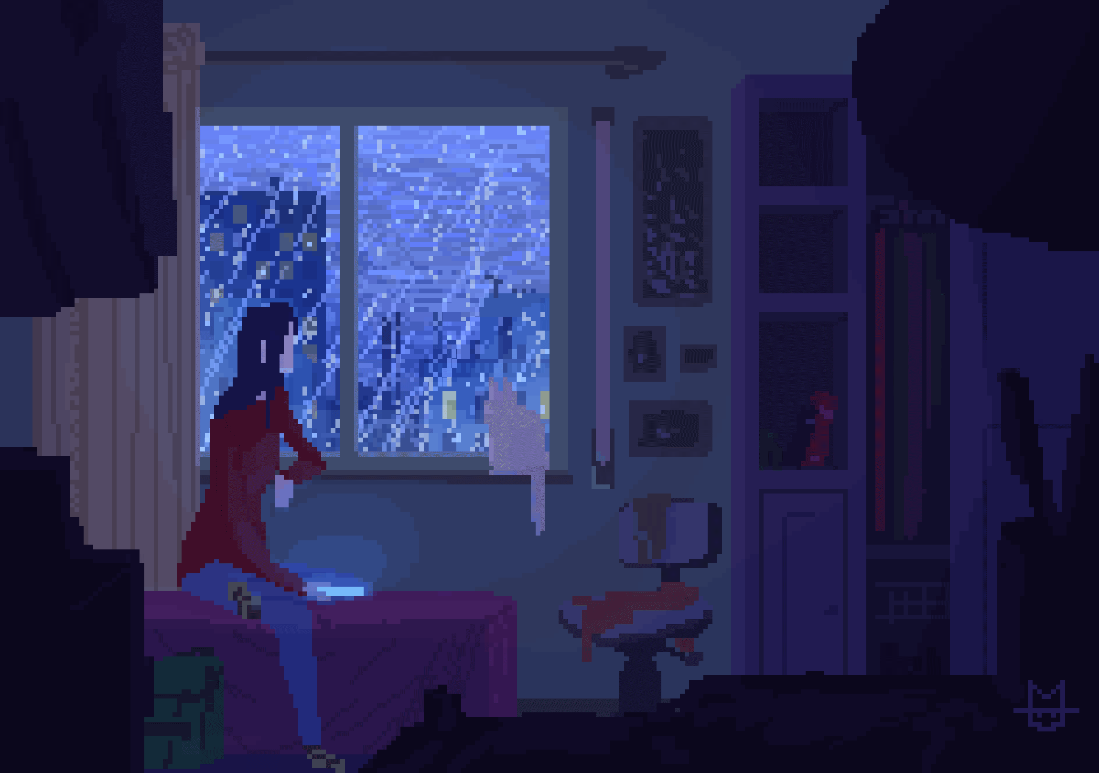
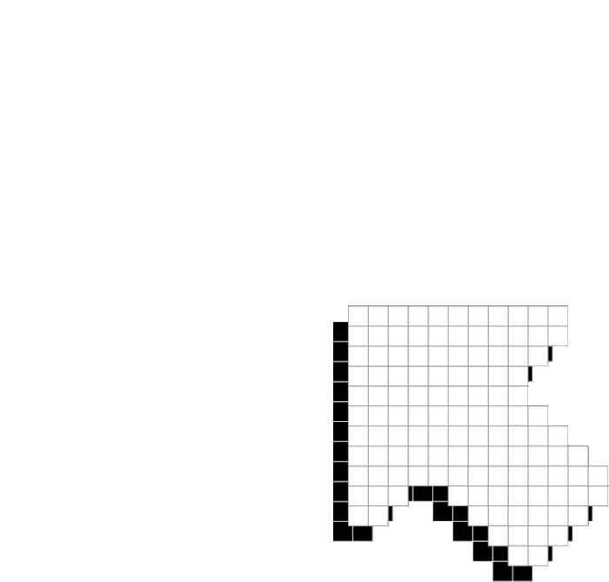
PETRICHOR
BY
Vedant talegaonkar ansh agrawal

Slide 2

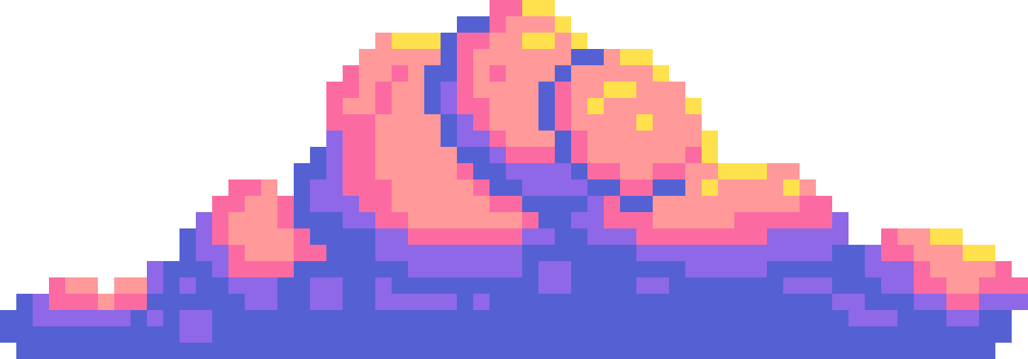
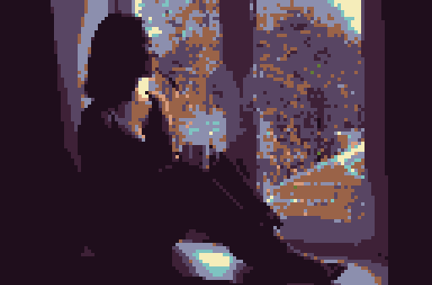
GAME CONCEPT
Our game PETRICHOR is based on depression. The aim of this game is to help with recovery from grief by engaging in positive activities and self-care.
The protagonist is a teenage girl suffering from depression due to the loss of a loved one. She is riddled with bad habits which keep affecting her mental state.
a depressed person does not have control over their bad habits, which therefore occur involuntarily in the game. the good tasks are what we can control to improve our state

Slide 3
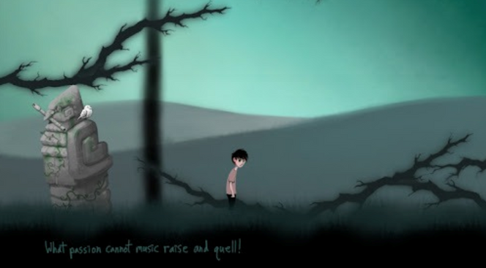
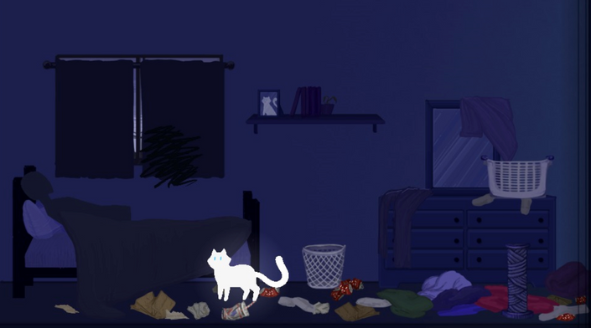
SOCIAL ISSUE
& INSPIRATION
In Elude, the mental state is shown through brightness of the surroundings and the music. the chirping of a bird is a positive stimuli. This approach to emulate depression in some sense was really interesting for us.
In the process of choosing the social issue to work upon, we encountered two unique and compelling games - Elude and One Day Better.
In One Day Better, we play the role of a cat - and the aim is to help our owner control their anxiety by engaging in the daily routine. This gave us the idea to include daily tasks as a way of improving mental health.

Slide 4

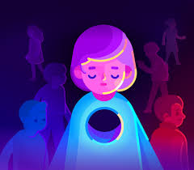
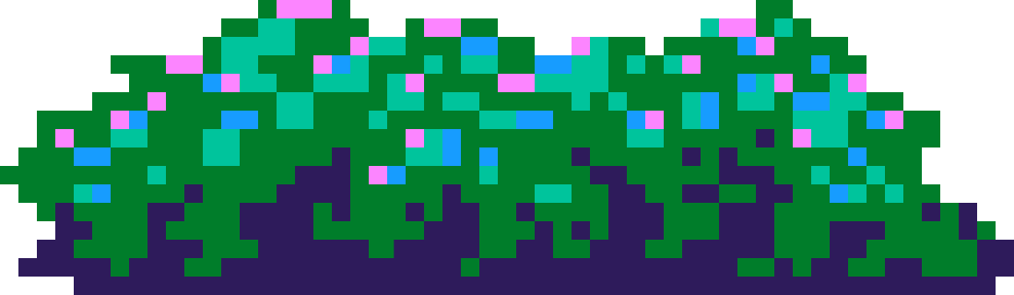
TARGET AUDIENCE
Our game is primarily an educational tool which will show the need to be disciplined and focus on your well-being.
The target audience of our game are early teens, as the education imparted is the most necessary for them.
Moreover, the protagonist belongs to the same age group, which will help them empathize with her.

Slide 5
FRAMEWORK
we chose pygame as the main framework to build our game for the following reasons:
MAIN MENU
INTRO
Scalability:
Due to less lines of code and an organized file structure we can easily build upon our existing code
01
02
Functions and features:
pygame’s extensive methods and utilities were helpful to speed up our code writing.
OUTRO
GAME
03
Tutorials:
availability of many tutorials helped us code the basic movement mechanics of the game swiftly.
LEVEL
PLAYER
04
Graphic support:
most of our scraped and created assets were easily incorporated into our game

Slide 6
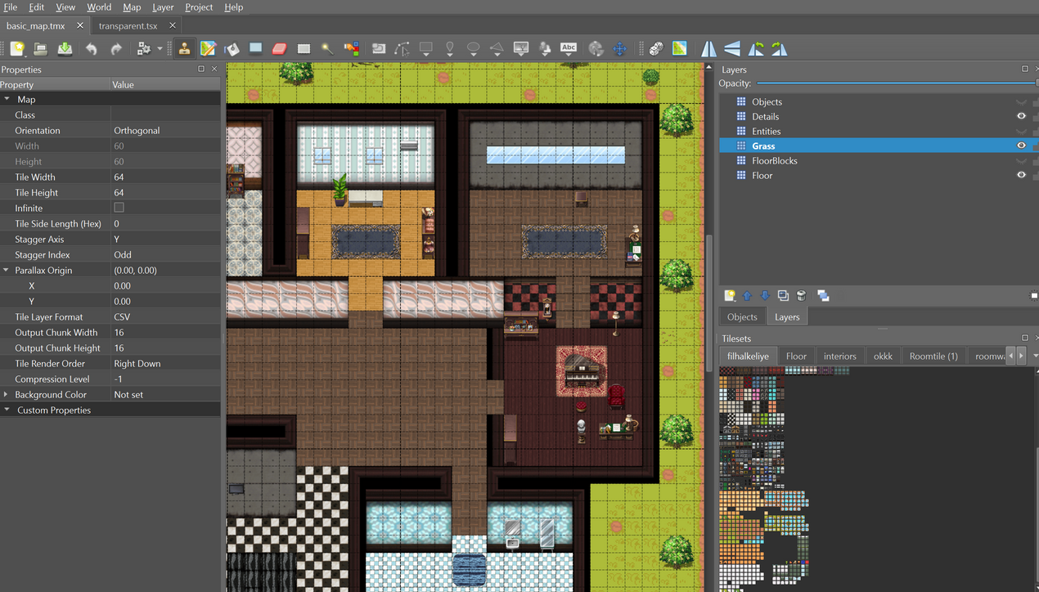
MAP DESIGN
we created a top down perspective game since we had grewe up with them. We have a Large map depicting the home of our protagonist.
we chose to create the map in Tiled. Working with tilesets was easy and we could its csv export to build our object interactions.
Scraping tilesets for the project was the hard part. Due to free assests being rare we had to combine some free resources. But we were able to achieve the required look.
We found decent resources on rpgmaker. But had to depend on resizing them for our project.
https://forums.rpgmakerweb.com/index.php?forums/rpg-maker-mv-resources.131/

Slide 7
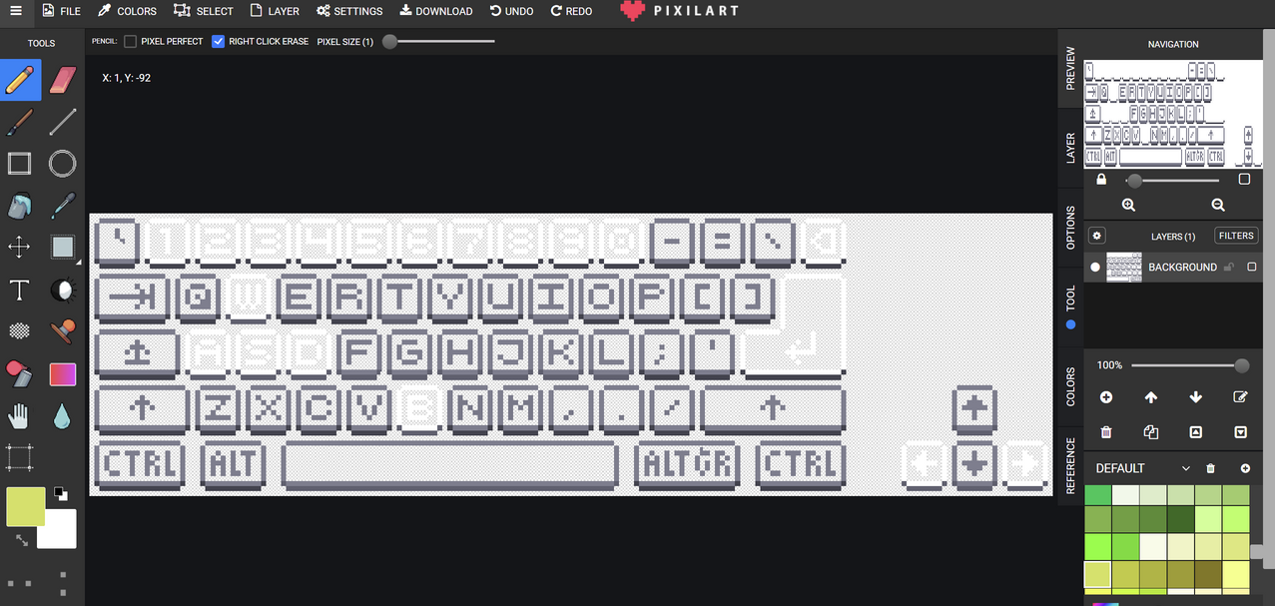

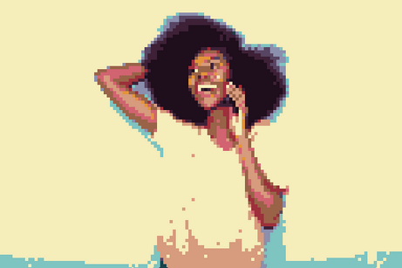
GRAPHICS
creating the graphics was the most important part of the project since we had to rely a lot on user interactions
we could not use most of the pixel art beacuse of it not being free or of high quality
we relied on pixelart.com and piskel.com to design the graphics for our tasks and sprites.
We created cutscenes by converting real images to pixel art scenes.

Slide 8
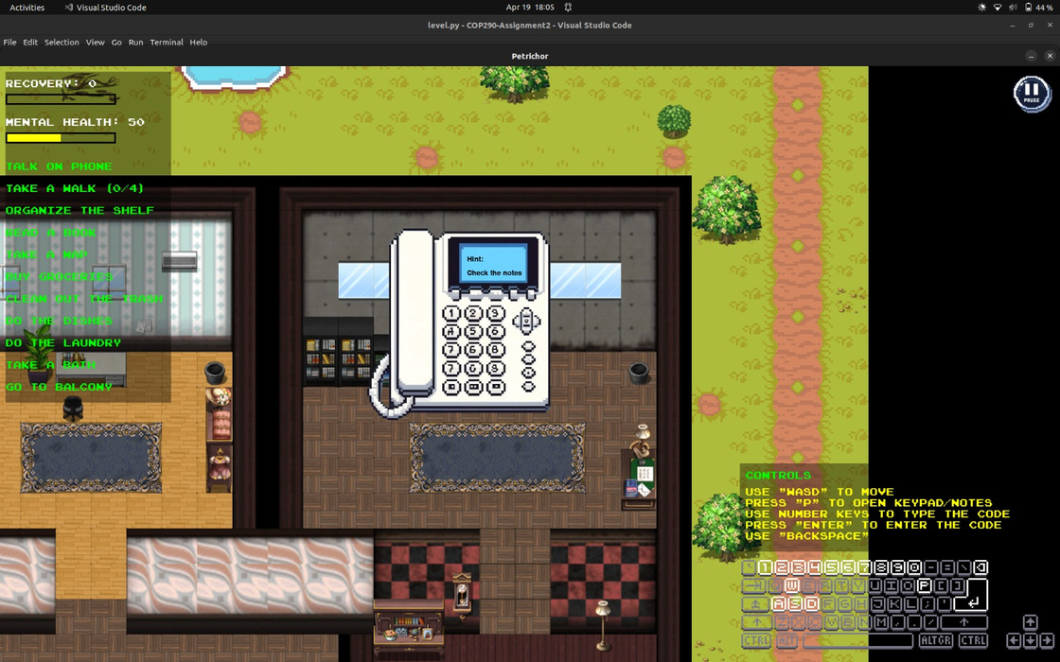
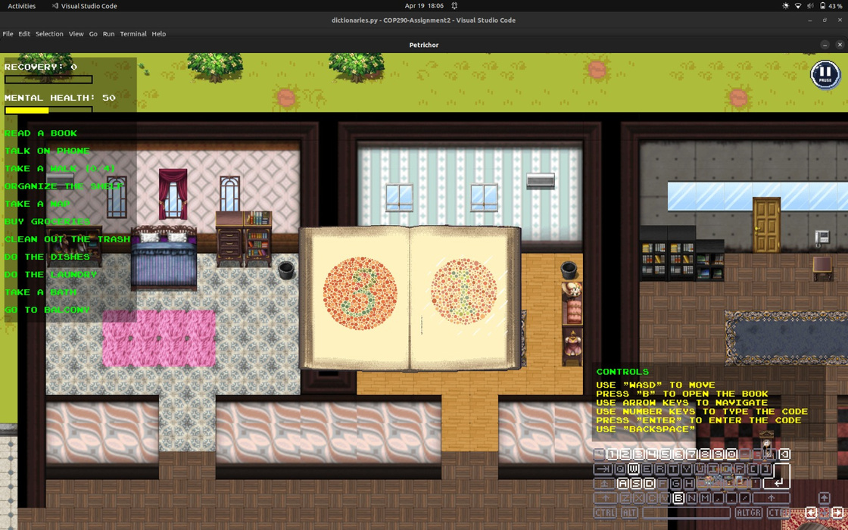
TASK MECHANICS
We have incorporated three kinds of task mechanicS:
In the phone task, we show a telephone keypad for which the user must find a code on the map.
IN the book task, we show pages of a book based on which the user must enter a code to complete the task.
In other tasks, the user must hold ‘i’ to complete the task. We have added task-wise features to all of the tasks to make it more engaging.

Slide 9
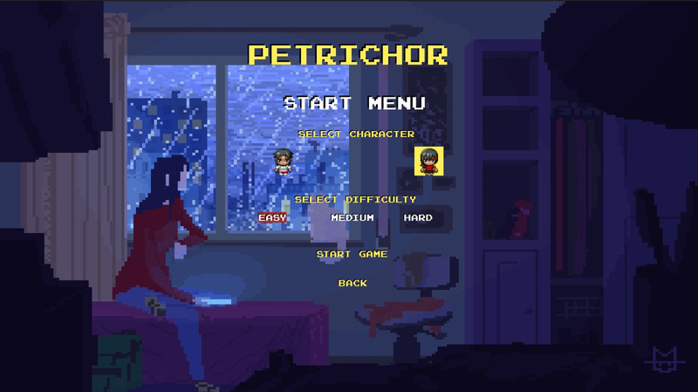
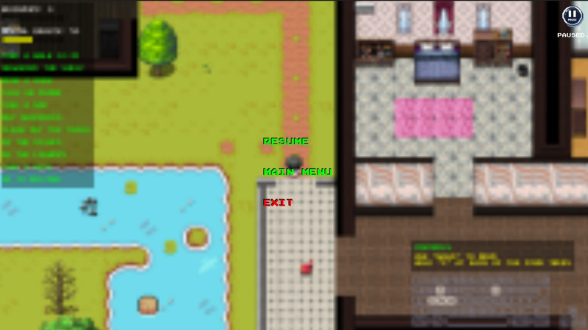
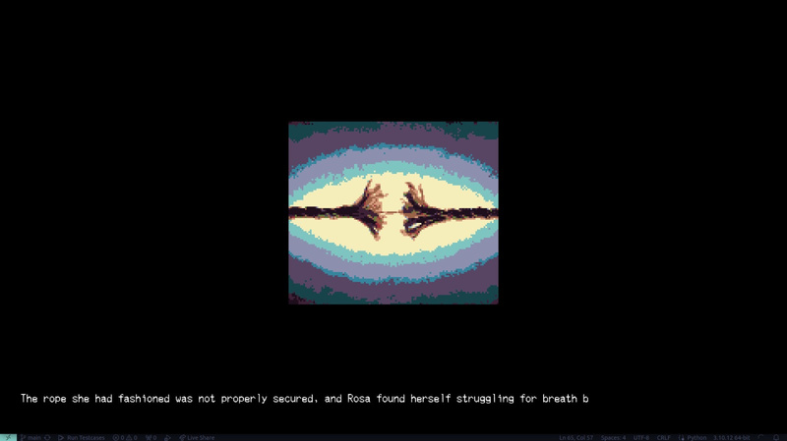
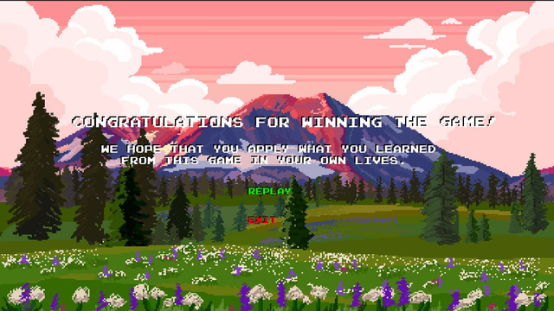
GENERAL UI
In OUR START MENU, WE OFFER the feature of choosing character and difficulty of the game, along with aesthetic feel.
we have included a pause menu for easy access and usability.
In the intro screen, we convey the backstory of the character.
we end our game with pleasing end screen along with animation.

Slide 10
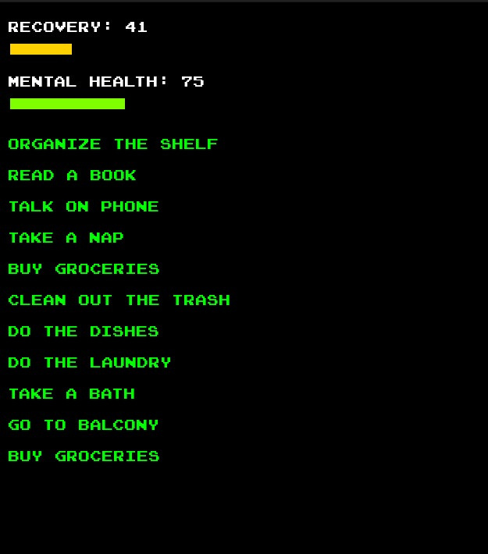
SCORING MECHANISM
& AUDIO
to suit better with the theme, we created/modified our audio files for better user experience. Moreover, we developed a proper mechanism to ensure that correct audio is played every time (say during a task / or in the main menu and so on)
the audio of the game has been set up keeping in mind the current mental state and task being performed.
the scoring mechanism of the game reflects the actual behavior of patients in depression.
in our game, the player wins if their recovery level reaches 100.
the way to reach this is that one needs to maintain their mental health over 75, as the recovery goes from 0 to 100.
this highlights the real world fact that recovery from depression cannot be achieved just by temporary bursts of happiness - it is a continuous process.

Slide 11
TRADEOFFS/PROBLEMS FACED
pygame doesn’t support gf files natively, therefore we had to break up gif into individual frames and dislay them sequentially. This increased latency and required significant logic change.
due to limited support for screen brightness we had to overlay a filter on our game screen to express the mood of the player. but we had to forgo it due to the latency of the computation.
since our game required interaction with tasks, we had to create a lot of tasks involving pixel art. finding or generating free art was definitely a challenge which took 30% of the time. we did a lot of png cleaning and transformations by writing python files ourselves.
our game is not compatible with all screen sizes to keep the pixel art consistent throughout the game.

Slide 12
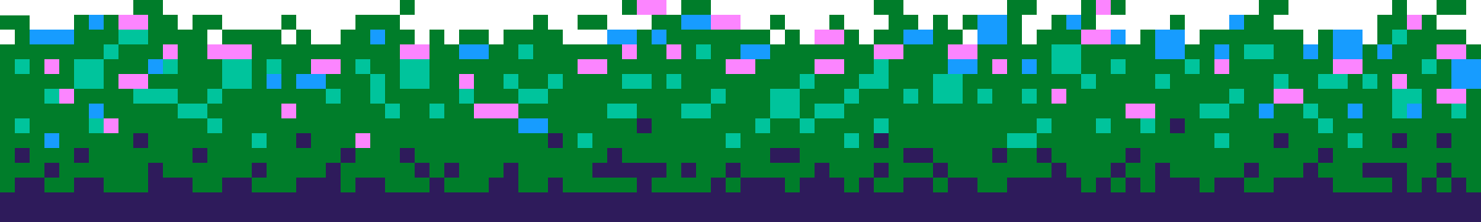
STRONGHOLDS
unique scoring mechanism
our scoring mechanism mimics the recovery pattern in actual patients with depression. the recovery starts only when the mental health is above a good threshold. It dips to 0 below it, like how depressed patients easily fall back on their progress with minute problems.
aesthetic pixel art & MAP
we made our map from scratch using web scraped tilesets. the map is engaging and beautiful. we added a wide variety of interactables to add more depth to the game using pixel art.
smooth transitions
while switch between various modes in the game we have applied smooth transitions to make it more realistic and visually pleasing,
mood settings
our choice of a/v assets has been done in correlation to the mental state of the player which adds another layer in the user experience.

Slide 13
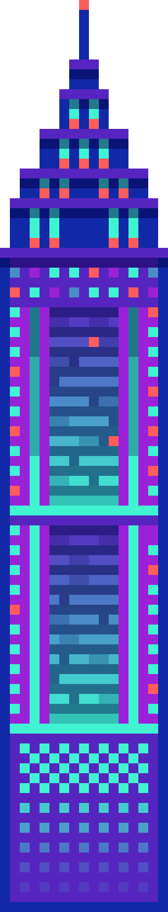
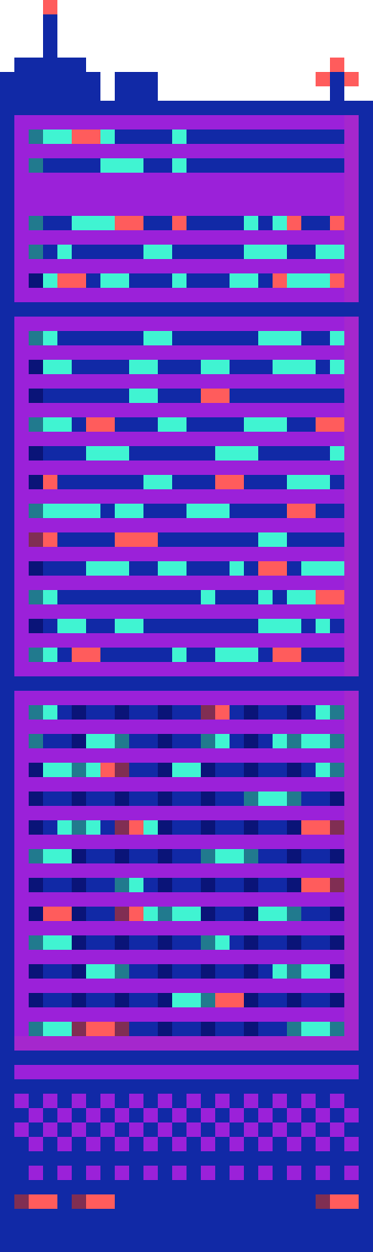

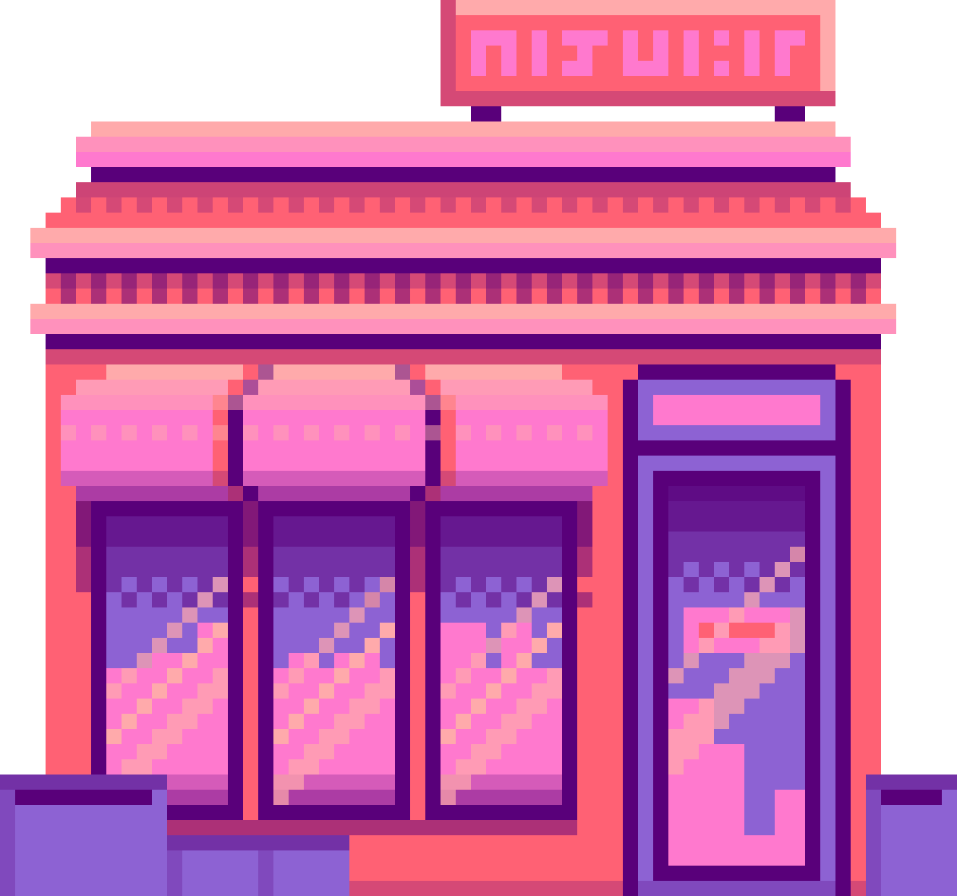
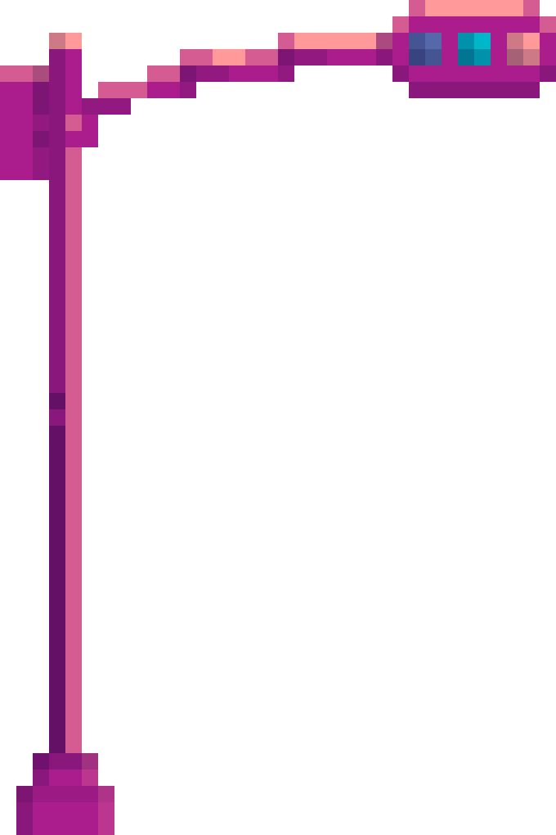
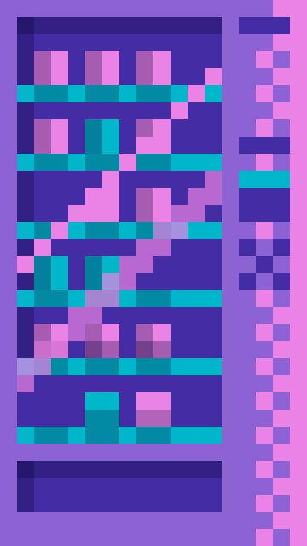
REFERENCES
Basic movement tutorial
Audio Assets
Tilesheets

Slide 14
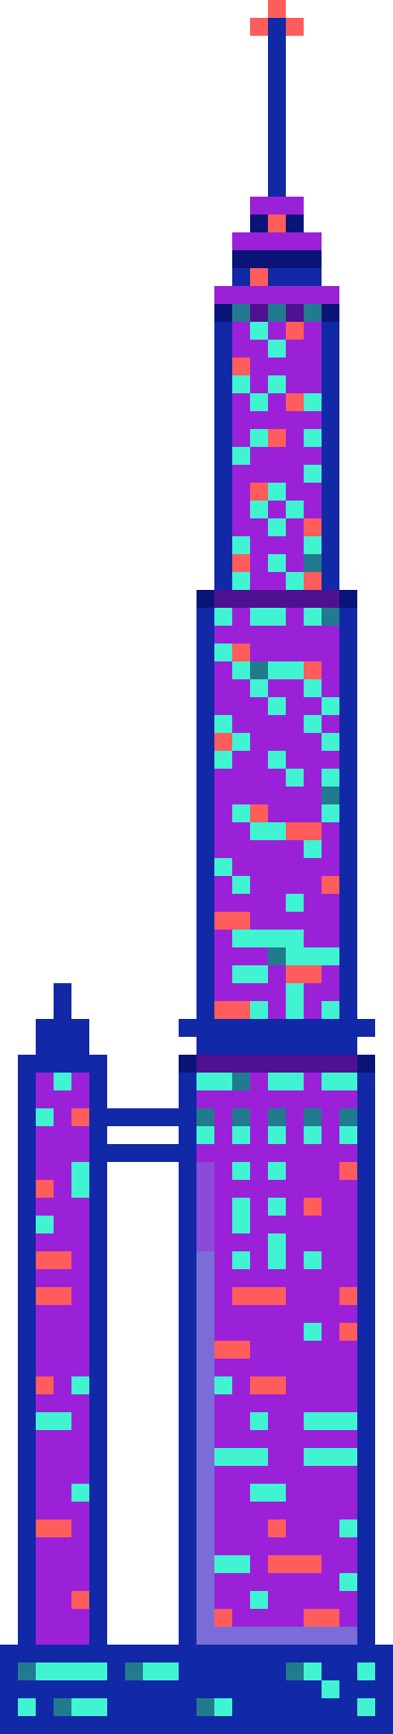
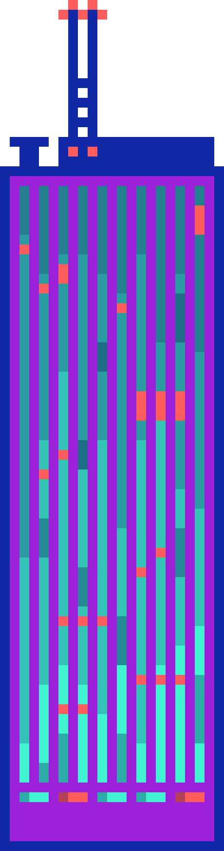
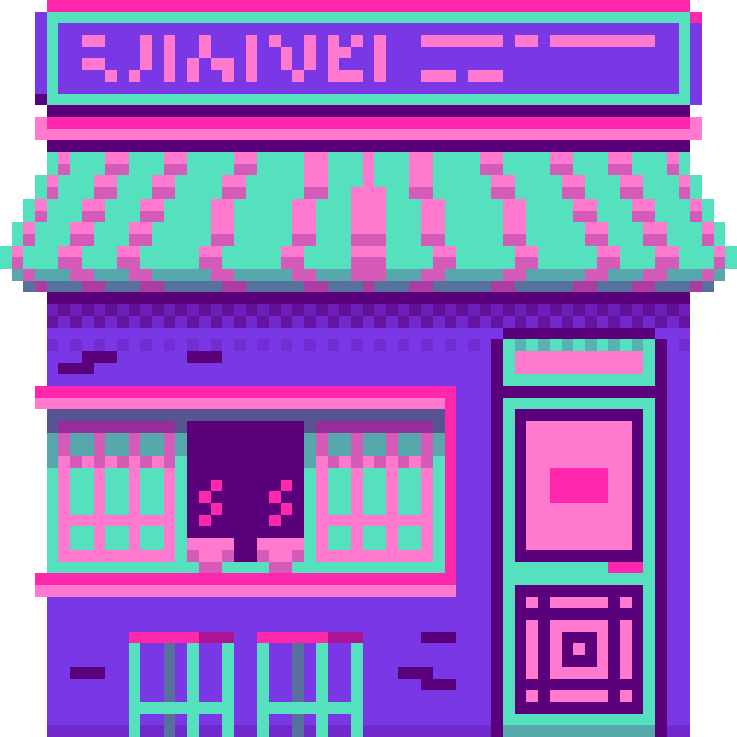
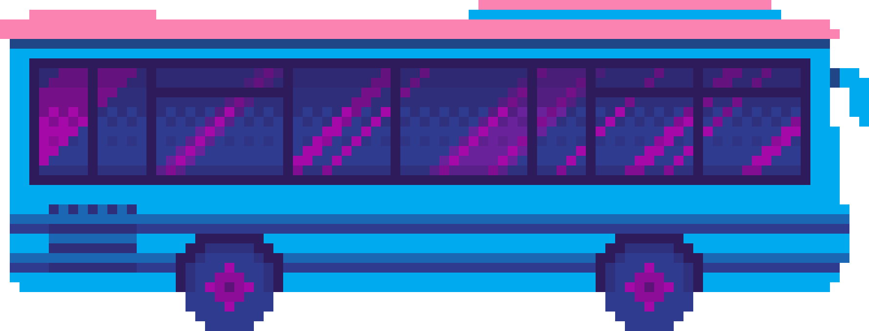
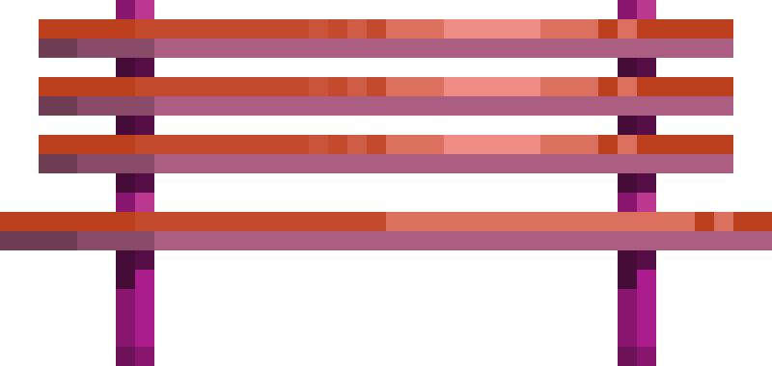
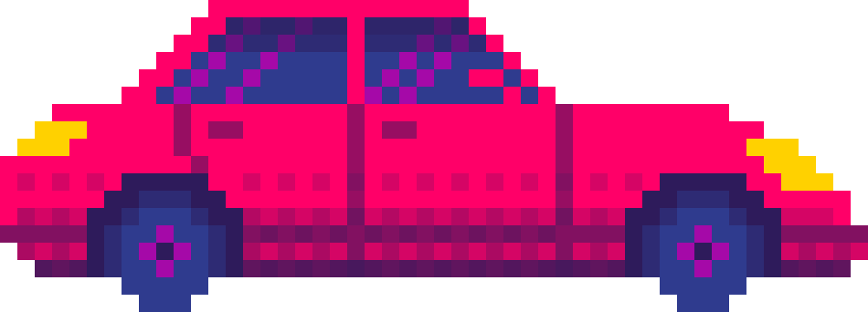
THANK
YOU

